Slide 1
Walmart Demand Forecasting Business Presentation
Presented by:
Imran Haider
Notes:
Culture! The most important asset a company can have. This was they key thing which I learnt during my 3 months here at CGAP.
The 9 constitution points which are hanging on the wall outside this room are not just mere bullet points you can feel those values while walking through the office and interacting with team.
This is Imran Haider from CGAP batch 22 and today I am at the climax of my CGAP journey.
And we are dealing with a problem here
Annual Profit Increase: $5 million
Typical Contract Duration: 3–5 years (a standard period to calculate value)
You could ask for 10-20% of the total value it delivers over a defined period. Let’s break this down:
3-year period: $5 million x 3 = $15 million in total profit increase.
10% of $15 million = $1.5 million (price for the model)
20% of $15 million = $3 million (price for the model)
5-year period: $5 million x 5 = $25 million in total profit increase.
10% of $25 million = $2.5 million (price for the model)
20% of $25 million = $5 million (price for the model)

Slide 2

Context
Leading retail store in US
Branches located across US
Problems in matching consumer demand
Notes:
In simple words there are people coming to their stores but they have nothing to sell them due to stock run out
Explain and quantify the severity of the problem
This is costing 0.5 million US dollars

Slide 3
Pain Points
Check all departments
Identify low stock items
Review sales data
Restock orders
Return processing
Figure 1: Walmart stock estimation and restock workflow
Notes:
In the frequent sessions with the team, we went through and through the supply chain process.
Interestingly everything was going fine except the methodology on which the stock was estimated for the next
Every store is independently estimating based on intuition and stats the next week’s expected stock which should not be problem right because
These guys are well trained and have years of experience but after a long discussion with this I found out they are missing some key insights which is affecting their estimation
“”Here I have to prove that this team is missing some key details””
They know that on holidays
Most of the time holidays
After a detailed analysis of the 45 key Walmart stores across US
The mechanics of this team need to be changed

Slide 4
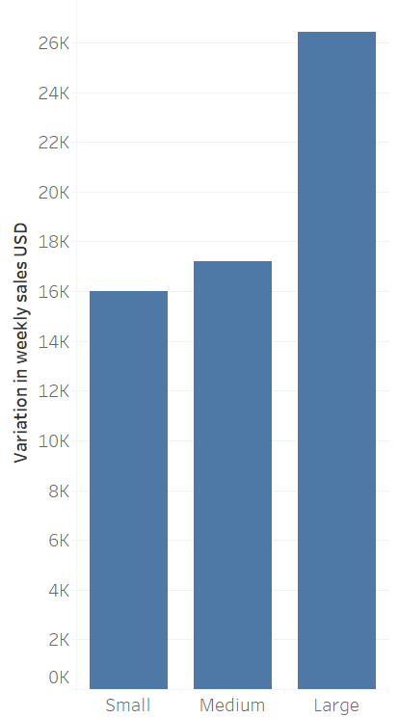
Pain Points
Figure 2: Sales variability for different store sizes
Notes:
Large stores are more affected by holidays that is why their sales vary a lot especially on the holidays and we are talking 1000’s of dollars for every store
There are 11 US holidays
Question you increase in the stock on every holiday

Slide 5
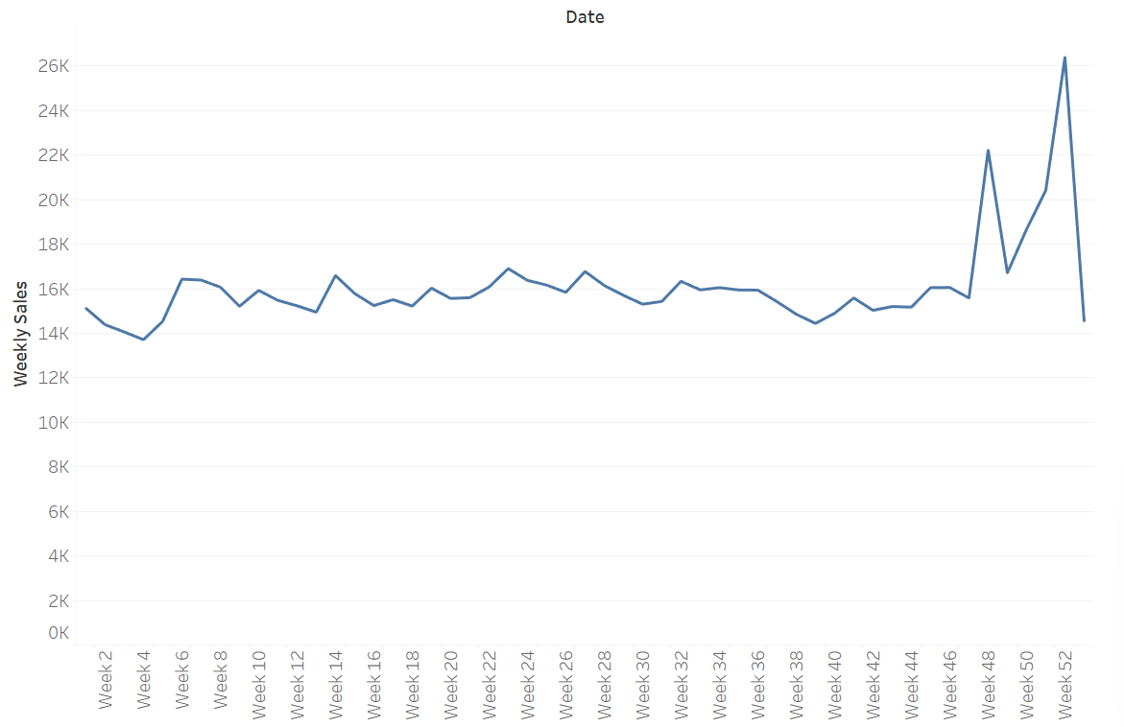
Pain Points
Figure 3: Weekly sales for the whole year
Notes:
There are certain spikes on specific weeks of the year which are affecting the sales
This pattern remains the same each year

Slide 6
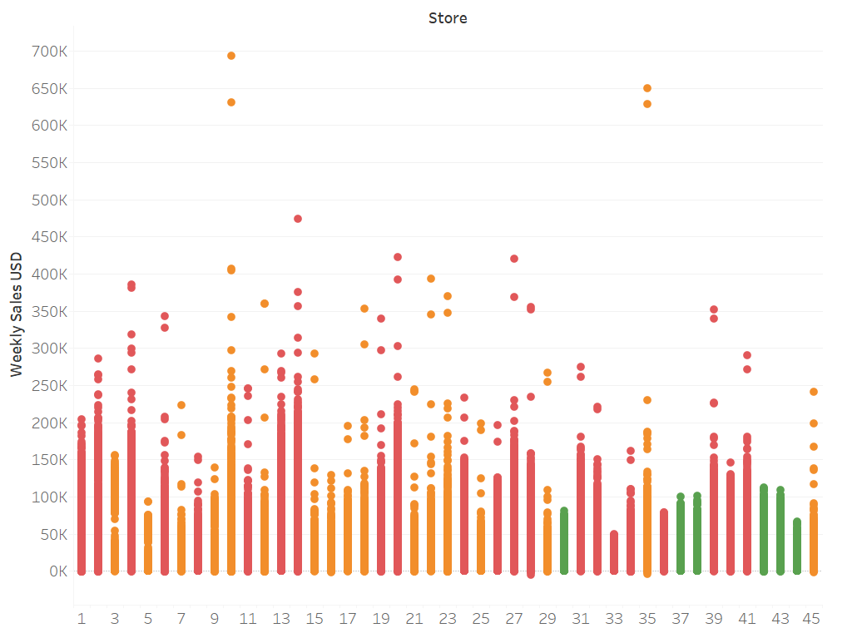

Pain Points
Temperature
Fuel Price
Inflation
Size
Small
Medium
Large
Figure 4: Store wise sales for different store sizes
Notes:
Its not that restock team doesn’t take holiday into account
There are other factors coming into play as well which elevate the spikes in sales to millions 10 Million US dollars every year
Prediction is what we need here
When went wrong
Costs you millions
Devestates customer satisfaction and the brand identity

Slide 7
Business Problem
Reducing the stock runout frequency of Walmart by 30% on a yearly basis by accurately predicting sales for different Walmart departments
Notes:
So, we need an accurate prediction on a departmental level wherein each department has a specific
This is not humanly possible to take all these variables into account and get a correct estimation

Slide 8
Solution
Gathered data of 45 Walmart stores
ML model to accurately predict future weekly sales
70% accuracy, especially holidays
30% decrease in stock runouts
Notes:
You need some machine learning magic here

Slide 9
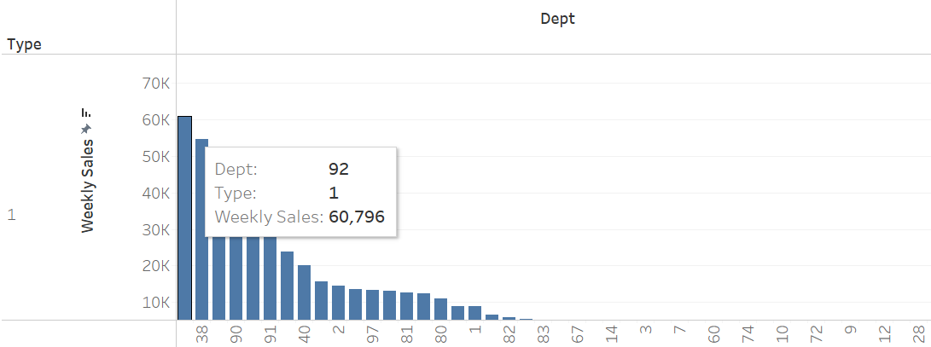
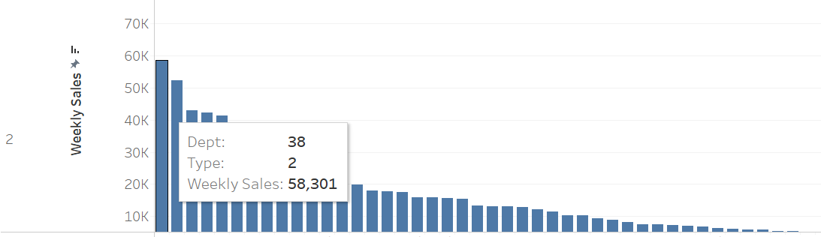
Caveats
Store Size
Small
Medium/ Large
Figure 4: Variation in department sales for different store sizes
Notes:
Retaining those millions you were losing by counting in the predictions of your model
Gives you a department wise break down for expected saels focus more on the high stock department and add specific discount offers and marketing strategies
We can improve this solution over the period as well
Markdown events information increase the accuracy of the prediction

Slide 10
Deployment
The model will be retrained each year
The stock team will be trained on how to get the prediction
Week of year | Store | Dept | Temperature | Fuel Price
Department wise sales for the coming week

Slide 11
Conclusion
Saving Walmart’s 5 million USD’s each year
Opening new windows for improved sales

